Slide 1
DATA STRUCTURES & ALGORITHMS
Intelligent Multi-Pattern Search Engine
A high-performance document analytics system built with advanced string matching algorithms.
PROJECT DOMAIN
COURSE
Text Retrieval & Analytics
Computer Science

Slide 2
The Brute-Force Bottleneck
O(N × M)
Quadratic time complexity fails at scale.
Traditional text search is completely unscalable for indexing millions of large documents.

Slide 3



Project Objectives
Linear Scaling
Phrase Matching
Document Analytics
Reduce execution time to O(N + M).
Fast multi-term and exact sequence lookups.
Automated term frequency computation.

Slide 4

Algorithmic Foundation
KMP Algorithm
Z-Algorithm
LPS array skips redundant checks.
Linear-time prefix length arrays.
Rabin-Karp
Suffix & LCP Arrays
Rolling hash multi-pattern matches.
Log-time sorted prefix lookups.

Slide 5






System Architecture Pipeline
Ingestion
Preprocessing
Indexing
Query Execution
Raw document parsing.
Tokenization and hashing.
Array and suffix generation.
Sub-second pattern lookup.

Slide 6

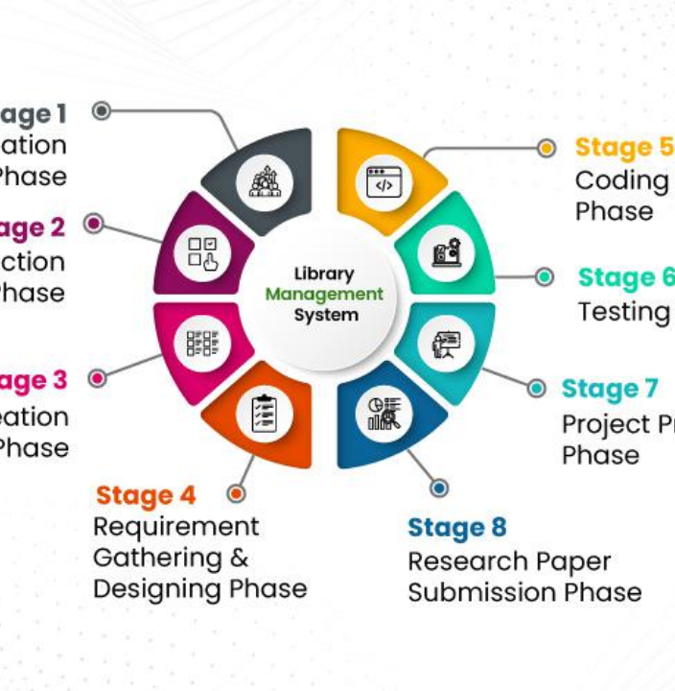
Apache Lucene Integration
Pre-computed index structures for rapid text retrieval.
Inverted Indices: Fast multi-term phrase mapping.
Fielded Searching: Title, author, and content metadata.

Slide 7




Development Stack
Java & Python
Apache Lucene
SQLite & MySQL
Graphviz
Core engine execution.
High-performance indexing.
Persistent document storage.
Dependency visualizations.

Slide 8

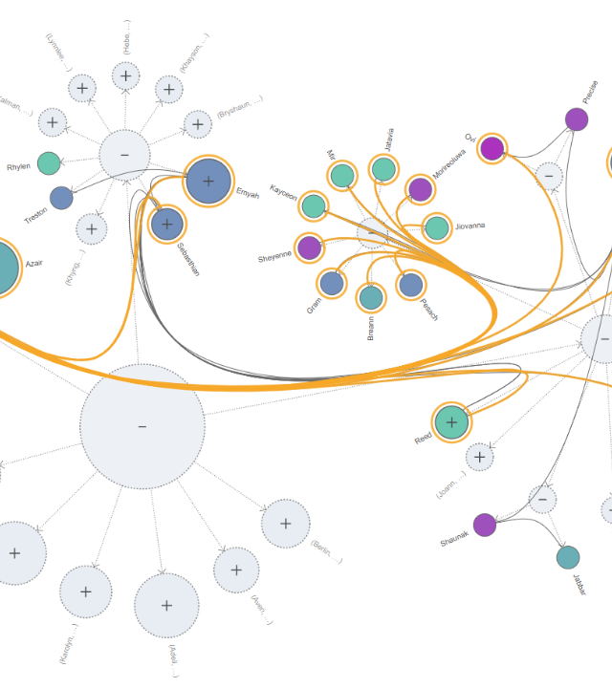
Dynamic Pattern Resolution
Multi-Term Hashing
Rolling hashes map complex queries instantly.
Prefix Array Scaling
Handles exponential node growth without latency drag.

Slide 9
Performance Benchmarks
600GB
<100ms
O(N)
Indexing throughput per hour
Multi-pattern query latency
Linear worst-case scaling

Slide 10
Application Domains
Web Search Engines
Digital Libraries
Enterprise Search
E-Learning
Core foundation for crawling, indexing, and keyword querying.
Full-text search across millions of research publications.
Instant retrieval of internal records and documentation.
Automated plagiarism detection and similarity analytics.

Slide 11

Enterprise-Ready Architecture
Combining pre-computed index arrays with optimal string matching algorithms for unlimited scale.

